Slide 1
Design Patterns
Chapter 7

Slide 2
Situation
A thoroughly tested application uses a particular class library
A new, competing product comes along that beats the snot out of the library they were using
  They’d love to just “plug it in”
But the new library’s interface is different
  And folks don’t want to have to change all their existing, working code
What’s the solution?

Slide 3
Adapting an Interface
Once again, the “create a new, intermediary abstraction” principle saves the day
Create a class that acts as a go-between:
  Rename methods
  Combine methods as needed to match old calls
  Whatever…
Think of electric plug adapters (pp. 236-237)
  They may just change the prong configuration
  Or they may convert voltage as well

Slide 4
The Adapter Pattern
Intent:
  Convert the interface of a class into another interface that clients expect. Let otherwise incompatible classes work together.
Context:
  You want to replace an existing server class with another (or a set of others), but its interface is different. You can’t or don’t want to change existing client code. You want disparate client and server classes to work together.
Solution:
  Create a class that implements the expected interface but translates client calls into the interface of the new server class. Clients call through this class to use the new service.

Slide 5
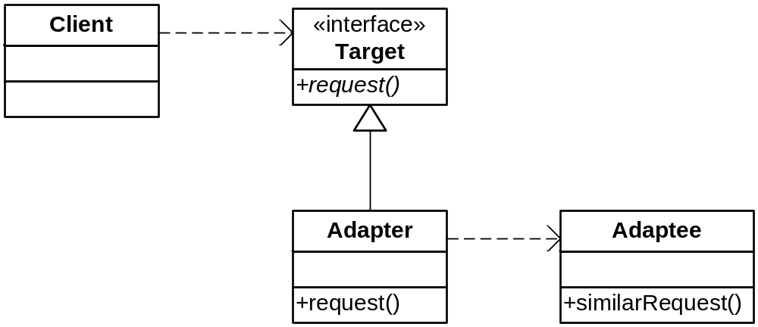
The Adapter Pattern
Class Sketch

Slide 6
Turkeys and Ducks
Turkeys gobble instead of quack, and only fly short distances
  But if all you have is a turkey when you want a duck, you’ll have to make do
Translate Duck.quack( ) into Turkey.gobble( )
Translate Duck.fly( ) into lots of Turkey.fly( ) segments…

Slide 7
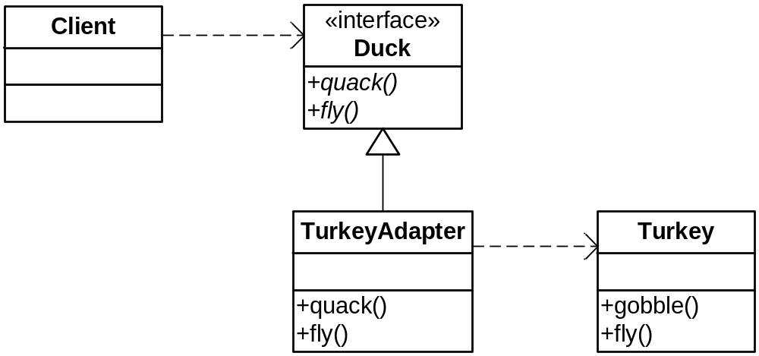
Ducks from Turkeys

Slide 8
Ducks from Turkeys
Code
public class TurkeyAdapter implements Duck {
Turkey turkey;
public TurkeyAdapter(Turkey turkey) {
this.turkey = turkey;
}
public void quack() {
turkey.gobble();
}
public void fly() {
for(int i=0; i < 5; i++) {
turkey.fly();
}
}
}

Slide 9
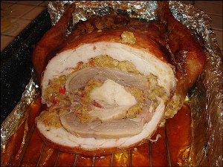
Real Life Application

Slide 10
Variation
You can also use multiple inheritance instead of composition
  Need SmallTalk, C++, Eiffel, or Python
  Private inheritance in C++!
Why would you want to do this?
You lose flexibility, but you gain efficiency
  The usual trade-off
See next slide, also pp. 243 - 247

Slide 11
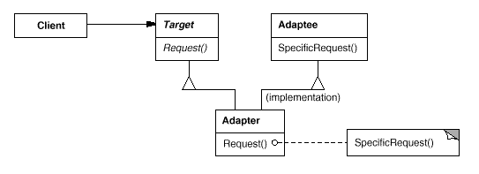
Class (vs. Object) Adapter

Slide 12
Object vs. Class Adaptor
Let’s see them in code…

Slide 13
Comments
What if there are multiple kinds of Turkeys?
  Not a problem: the adaptor binds to the base class; could use any Turkey subclass – cool!
The Target can be an interface, rather than a base class – then you can use the class adaptor in Java
  … IF you have an interface and not a class
A couple of additional comments: No Dumb Questions, p. 242
How well does it fit with our use of Duck Behaviors (strategy)?
  Not very…

Slide 14
Fowl Magnets
Do exercise on p. 245

Slide 15
Variation
2-way Adapters
Note: You can no longer use the adapted Turkey as a Turkey
  Usually not a problem
On rare occasion, however, you may want both interfaces supported
This is known as a 2-way adapter
  Can use where either interface is needed
  See next slide

Slide 16
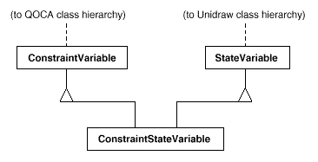
2-way Adapters

Slide 17
C++ Adapters
As usual, use implicit interfaces
  Via templates
You’ve already seen container adapters
  Queue uses vector, deque or list internally
There are also function object adapters
  Like bind2nd
Warning, C++ detour ahead…
  The “interface” is the function call

Slide 18
Adaptable Function Objects
Function Objects that derive from unary_function or binary_function
Standard function object adapters use argument and return types

Slide 19
An Adaptable byname
Version 1
    struct byName
    {
    typedef bool return_type;
    typedef Person argument_type;
    string name;
    byName(const string& s) : name(s) {}
    bool operator()(const Person& p)
    {
    return p.name == name;
    }
    };

Slide 20
An Adaptable byname
Version 2
    struct byName : unary_function<Person, bool>
    {
    string name;
    byName(const string& s) : name(s) {}
    bool operator()(const Person& p)const
    {
    return p.name == name;
    }
    };
    // argument_type == Person
    // result_type == bool

Slide 21
Function Object Adapters
Function Templates
Return new function objects from existing ones
Used to create sophisticated function objects on demand
Rarely have to actually write a function yourself!

Slide 22
Function Object Adapter
Example - not1
// Find first Person that is not “Charles”
Person* p = find_if(a, past,
not1(byName("Charles")));

Slide 23
Implementation of not1
template<class UF>
unary_negate<UF> not1(const UF& uf)
{
return(unary_negate<UF>(uf));
}

Slide 24
Implementation of unary_negate
template<class UF>
struct unary_negate
: unary_function<UF::argument_type, bool>
{
explicit unary_negate(const UF& uf) : fn(uf) {}
bool operator()(const UF::argument_type& x) const
{
return (!fn(x));
}
protected:
UF fn;
};
// Assumes return type of fn is bool

Slide 25
How not1 works in find_if
In find_if, the expression:
  if (p(*start))
becomes
  if (not1(byName(“Charles”))(*start))
which further reduces to
  if (!byName(“Charles”)(*start))
and finally to
  if (!((*start).name == “Charles”))

Slide 26
An Alternative to byName
Person v(“Charles”, 1897, 3, 11);
find_if(a, past, bind2nd(equal_to<Person>(), v));
You don’t even have to write a function!
equal_to is a predefined binary function object
bind2nd binds v to the 2nd parm of equal_to
But this still compares complete objects, so...

Slide 27
Comparing on Name Only
struct byName : binary_function<Person, string, bool>
{
bool operator()(const Person& p,
const string& s) const
{
return p.name == s;
}
};
…
find_if(a, past, bind2nd(byName(), “Charles”));

Slide 28
Bind2nd: creates an adaptor
Template <class Operation, class T>
binder2nd<Operation> bind2nd (const Operation& op,
const T&, x)
{
return binder2nd<Operation>(op,
typename Operation::arg2_type(x));
};

Slide 29
Binder2nd: a binary to unary adaptor
Template <class Op> class binder2nd
: public unary_function <typename Op::arg1_type,
typename Op::res_type>
{
protected:
Op op;
typename Op::arg2_type value;
Public:
binder2nd(const Op& x, const typename Op::arg2_type& y) :
op(x), value(y) {}
typename Op::res_type
operator()(const typename Op::arg1_type& x) const
{
return op(x, value);
}
};

Slide 30
The Best Approach Yet!
Using ptr_fun
bool byName(const Person& p, const string& s)
{
return p.name == s;
}
find_if(a, past, bind2nd(ptr_fun(byName), “Charles”));
Note: C++0x makes binding MUCH easier!

Slide 31
Analysis
The compiler deduces that byName is a binary function
ptr_fun returns a pointer_to_binary_function (let’s call it pbf), which stores the address of byName
bind2nd creates a binder2nd (call it b2), a unary function object that stores the value “Charles”, as well as pbf
The expression p(*start) in find_if invokes b2(*start)
b2(*start) is really b2.operator()(*start), which invokes pbf(*start,”Charles”), which is really byName(*start,”Charles”)

Slide 32
Run that by me Again!
ptr_fun(byName)
pbf // binary, stores &byName
bind2nd(pbf, “Charles”)
b2 // unary, stores “Charles”, pbf
b2 becomes the predicate p in find_if

Slide 33
Yeah, and Then What Happens?
p(*start)
b2.operator()(*start)
pbf.operator()(*start, “Charles”)
byName(*start, “Charles”)
return (*start).name == “Charles”

Slide 34
A Java Example
You know that iterators have replaced enumerations in Java
But what if you have old code that you want to use with modern iterators
  You want to adapt enumerations to behave like iterators
See pages 248 - 250

Slide 35
Adapters vs. Decorators
Decorators don’t change the interface
  And they add new behavior
    (not a simple pass-through)
  And they allow layering
Adapters change the interface
  And can adapt multiple classes at once

Slide 36
External Polymorphism
A Variation of Adapter
Suppose you have totally unrelated classes, but you want to treat them polymorphically
  e.g., you want to dump the contents of objects
You can force them to be in the same hierarchy
  Just create wrappers that inherit from a common interface

Slide 37
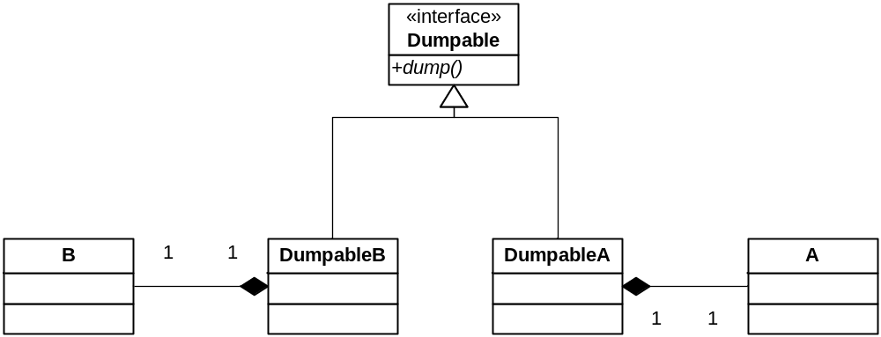
External Polymorphism
See externalpoly.cpp

Slide 38
Fat Interfaces
This attractive term refers to large interfaces
They tend not to be cohesive
  They try to do too much at once
  And confuse clients
This may be unavoidable in practice
  So just “disassemble” them

Slide 39
ISP
The Interface Segregation Principle
  (Not in the book)
Clients should not be forced to depend on (grok) methods they do not use.
  Interfaces belong to clients, not implementations.
Give clients a thin interface!

Slide 40
A Security System
We have a Door hierarchy of objects that lock and unlock
  Door is an abstract class
Suppose we want to implement a TimedDoor
  Sounds an alarm when a door is left open too long
TimedDoor needs to be informed of a timeout
  So it registers with a Timer
    A server, which communicates with TimerClients
What is the relationship between these classes?

Slide 41
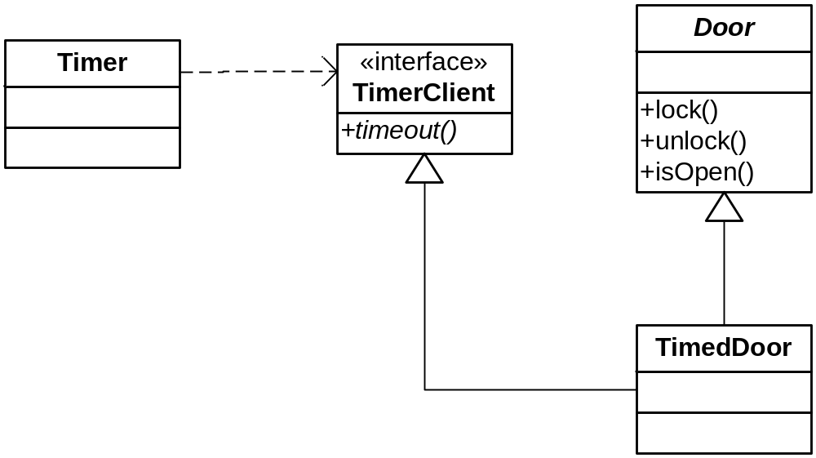
The Best Solution
Adheres to ISP

Slide 42
An Adaptive Alternative
What if TimerClient is an abstract class?
  And multiple inheritance is not an option?
We can create an object adapter that adapts TimedDoor to TimerClient
Next Slide

Slide 43
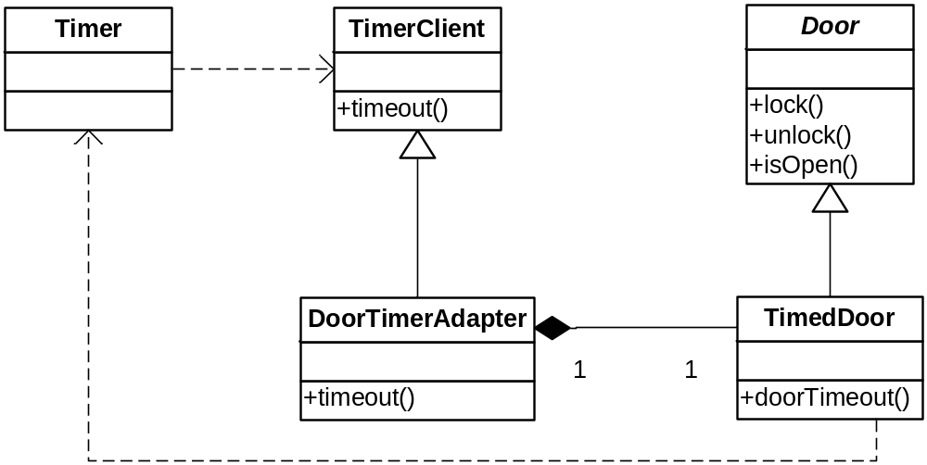
An Adaptive Alternative
TimedDoor creates its own DoorTimerAdapter.
The latter enables TimedDoor to be a callback.

Slide 44
Lesson
Separate Clients means Separate Interfaces
Don’t mess with Door
  e.g., don’t make it a TimerClient
Don’t mess with TimerClient
  Don’t make it know about doors
Don’t create a monster object that acts like both

Slide 45
Time for a New Pattern
It’s related to Adaptor…

Slide 46
A Twist
What if you have bunch of classes that weren’t made to work together, but now you have to use them in concert
Example: home entertainment system
  Receiver
  VCR
  DVD Player
  Speakers
  TV, Screen, etc.
Made by different vendors (see page 255-256)
  Can these components work together?

Slide 47
The Universal Remote
Know what I’m talking about?
I use one remote for three components
  TV, VCR, DVD Player
  Speaker remote is separate
The Universal Remote simplifies the interface for me
Many systems evolve this way
  You build a component, then another, then another, and you grow weary of invoking and combining them separately… so you build a “front end”

Slide 48
The Façade Pattern
Structural
Intent:
  Provide a unified interface to a set of interfaces in a subsystem. Facade defines a higher-level interface that makes the subsystem easier to use.
Context:
  You have a lot of existing classes that aren’t tied together by a single interface, but you want to use them together. You want a single interface to this collection of classes.
Solution:
  Provide a single, higher-level interface for clients that coordinates the use of the classes behind the scenes. Advanced clients with special needs can still dig deeper to the existing component classes if they need to, but the default user is shielded from all the complexity.

Slide 49
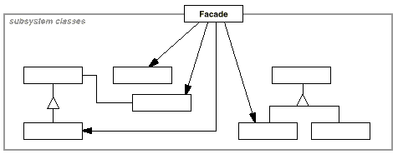
The Façade Pattern
Class Sketch
See page 258…

Slide 50
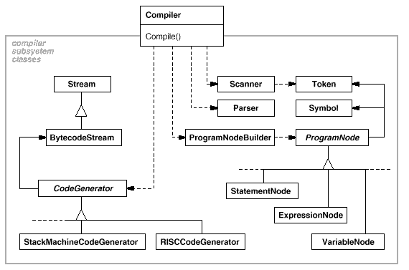
Compilers as a Façade

Slide 51
Onion Boy Redux
Systems can have layers of complexity
Introduce a façade for each layer, as needed
Such a deal!

Slide 52
Façade at the Architectural Level
The Layers Architectural Pattern
Each layer is a façade that covers the functionality below it
Each successive layer:
  Specializes the layer below it
  Simplifies
  Adds context (e.g., business logic)

Slide 53
Façade vs. Adapter
Very similar
But as always, they differ in intent
Façade gives a complex subsystem a single, simple interface
  Decouples client from the various components of the subsystem
So Façade simplifies, Adapter converts
See page 260

Slide 54
The Principle of Least Knowledge
Law of Demeter
“Don’t talk to strangers!”
Classes should only send requests to:
  Fields objects
  Method parameters
  Anything it creates
Don’t penetrate layers
See pages 265-269
www.ccs.neu.edu/home/lieber/LoD.html

